Slide 1
Growing in Christ
His strength
CK&L
Emiliano Romero
2/16/2025

Slide 2
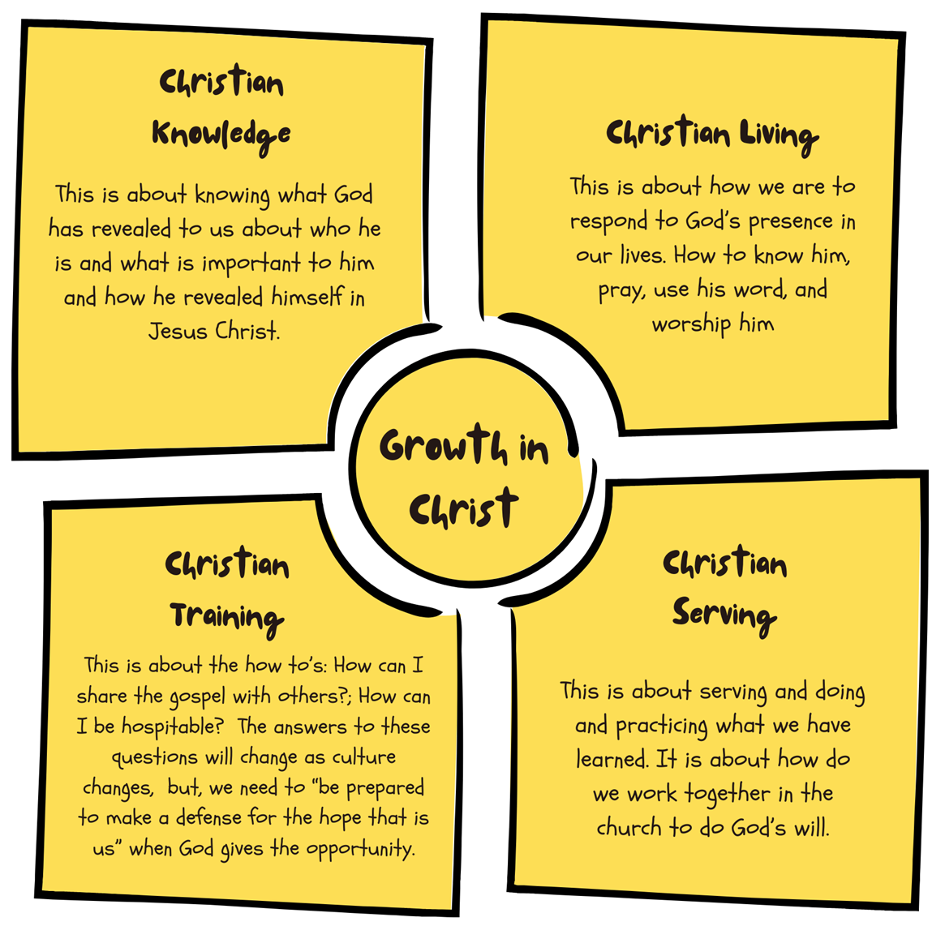

Slide 3
.God is the source of strength
.Dependance on Christ
.Victory through God’s strength
.Renewal through the Word
.Walking by the Spirit

Slide 4
God is the source of strength
He gives power to the faint, and to him who has no might he increases strength.
30
Even youths shall faint and be weary, and young men shall fall exhausted;
31
but they who wait for the Lord shall renew their strength; they shall mount up with wings like eagles; they shall run and not be weary; they shall walk and not faint.
Isaiah 40:29-31

Slide 5
Dependance on Christ
I am the vine; you are the branches. Whoever abides in me and I in him, he it is that bears much fruit, for apart from me you can do nothing.
John 15:5

Slide 6
Victory through Gods strength
10 Finally, be strong in the Lord and in the strength of his might.
Ephisians 6:10

Slide 7
Renewal through the Word
28
My soul melts away for sorrow; strengthen me according to your word!
Psalm 119:28

Slide 8
Walking by the Spirit
6 Then he said to me, “This is the word of the Lord to Zerubbabel: Not by might, nor by power, but by my Spirit, says the Lord of hosts
Zechariah 4:6

Slide 9
Philippians 4:13
I can do all things through Him who strengthens me

Slide 10
1.How does this chapter encourage perseverance in faith, even in difficult times?
2.How does the chapter challenge you to evaluate your personal commitment to following Christ?
3.What Scripture verses from this chapter stood out to you the most, and how can they impact your walk with Christ?
4.List one activity ,project, or task in the next week in which you will need to consciously claim the promise of Phillipians 4:13 and actively rely upon Christs strength.

