Slide 1
God’s WORD
Steve Shenk
2/23/2025

Slide 2
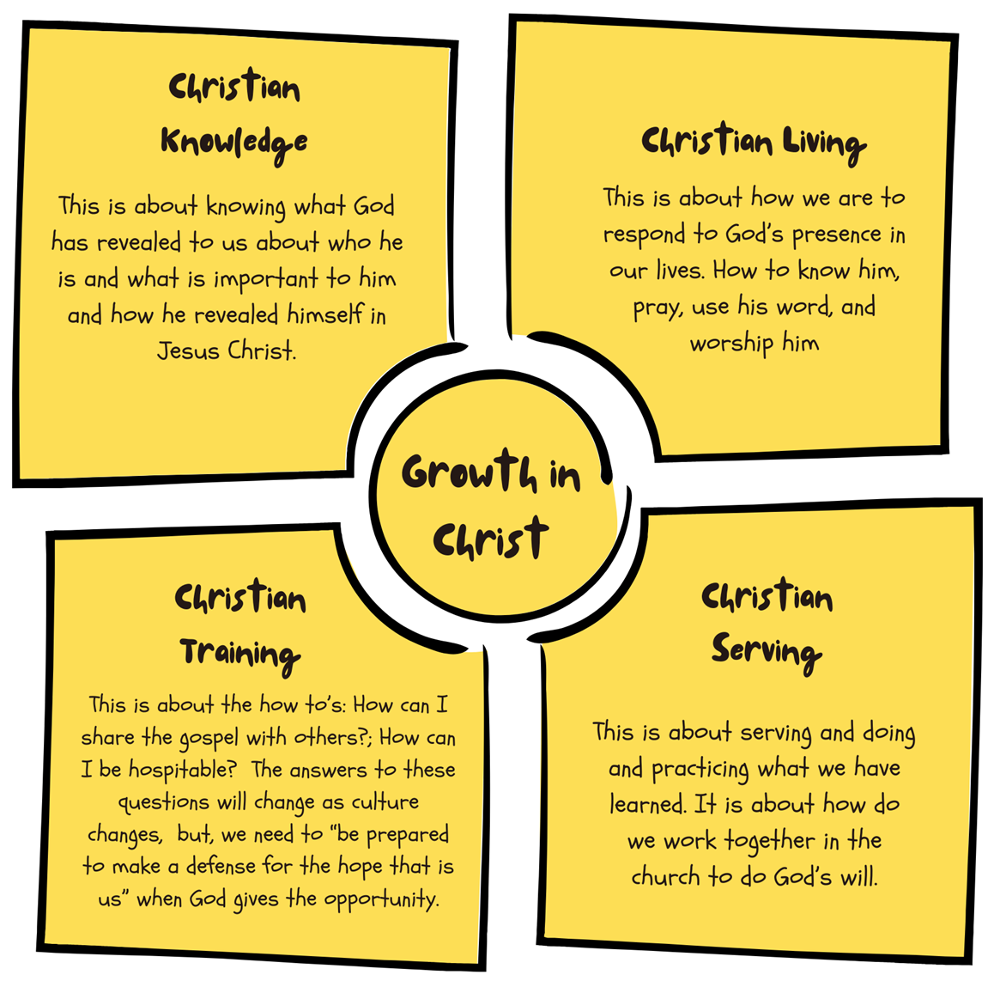

Slide 3
God’s Word
Psalm 119:9,11 How can a young man keep his way pure?
By guarding it according to Your word. (9)
I have stored up Your word in my heart,
that I might not sin against You. (11)

Slide 4
Why Is God’s Word Important?
John 1:1-3 In the beginning was the Word, and the Word was with God, and the Word was God. ² He was in the beginning with God. ³ All things were made through Him, and without Him was not any thing made that was made.

Slide 5
“The Mind of God Became a Man” – Wm Barclay
John 1:14 And the Word became flesh and dwelt among us, and we have seen His glory, glory as of the only Son from the Father, full of grace and truth.

Slide 6
God-Breathed, Jesus-Breathed
2 Timothy 3:16 All Scripture is breathed out by God and profitable for teaching, for reproof, for correction, and for training in righteousness
2 Peter 1:21
For no prophecy was ever produced by the will of man, but men spoke from God as they were carried along by the Holy Spirit.

Slide 7
Bad Counsel – Good Counsel
Psalm 1:1-2 Blessed is the man who walks not in the counsel of the wicked, nor stands in the way of sinners, nor sits in the seat of scoffers; but his delight is in the law of the Lord, and on His law he meditates day and night.

Slide 8
Importance of God’s Word
Joshua 1:8 This Book of the Law shall not depart from your mouth, but you shall meditate on it day and night, so that you may be careful to do according to all that is written in it. For then you will make your way prosperous, and then you will have good success.

Slide 9
Importance of God’s Illumination
Psalm 119:18 Open my eyes, that I may behold wondrous things out of your law.

Slide 10
Eternal Results of God’s Word
Psalm 119:93 I will never forget Your precepts, for by them You have given me life.

Slide 11
God’s Word What It Is & What It Does
Psalm 19:7-8 The law of the Lord is perfect, reviving the soul; the testimony of the Lord is sure, making wise the simple; ⁸ the precepts of the Lord are right, rejoicing the heart; the commandment of the Lord is pure, enlightening the eyes;

Slide 12
Importance of Spiritual Sustenance
Matthew 4:4 But He answered, “It is written,
“‘Man shall not live by bread alone, but by every word that comes from the mouth of God.’”

Slide 13
Effects of God’s Word
Colossians 3:16 Let the word of Christ dwell in you richly, teaching and admonishing one another in all wisdom, singing psalms and hymns and spiritual songs, with thankfulness in your hearts to God.

Slide 14
Pass It On…
Deuteronomy 6:6-7 And these words that I command you today shall be on your heart. ⁷ You shall teach them diligently to your children, and shall talk of them when you sit in your house, and when you walk by the way, and when you lie down, and when you rise.

Slide 15
Ouch… It Hurts!
Hebrews 4:12 For the word of God is living and active, sharper than any two-edged sword, piercing to the division of soul and of spirit, of joints and of marrow, and discerning the thoughts and intentions of the heart.

Slide 16
Make It Your Home
John 8:31-32 So Jesus said to the Jews who had believed Him, “If you abide in my word, you are truly my disciples, ³² and you will know the truth, and the truth will set you free.”

Slide 17
Make It Your Home
John 15:3-5 Already you are clean because of the word that I have spoken to you. ⁴ Abide in me, and I in you. As the branch cannot bear fruit by itself, unless it abides in the vine, neither can you, unless you abide in me. ⁵ I am the vine; you are the branches. Whoever abides in me and I in him, he it is that bears much fruit, for apart from me you can do nothing.

Slide 18
Danger of Ignoring God’s Word
James 1:22-24 But be doers of the word, and not hearers only, deceiving yourselves. ²³ For if anyone is a hearer of the word and not a doer, he is like a man who looks intently at his natural face in a mirror. ²⁴ For he looks at himself and goes away and at once forgets what he was like.

Slide 19
The Blessing of Application
James 1:25 But the one who looks into the perfect law, the law of liberty, and perseveres, being no hearer who forgets but a doer who acts, he will be blessed in his doing.

